Slide 1
BEAMFORMING
Alberto Facheris
Thibault Fievez
Reza Kenari
Vasile Liposchi

Slide 2
Assumptions
2 static users
2 static interferers
LoS 3GPP channel
No doppler shift nor frequency offsets in local oscillators
Users spaced enough to allow SDMA
OFDM and QAM are used to transmit the data

Slide 3
Proceeding and goal
Generate the channel and the scenario
Create beamformer for each user (LMS)
Calculate the BER
Compare the results with and without beamforming
Compare the results varying SNR, number of antennas, bandwidth and positions of the users

Slide 4
Proceeding and goal
256 subcarriers with 15kHz spacing
Cyclic prefix of 5µs (20 taps)
8 guard subcarriers at each side
150 OFDM symbols transmitted by each user and each interferer
30 different pairs of positions of the users are analyzed and used to calculate the average BER

Slide 5
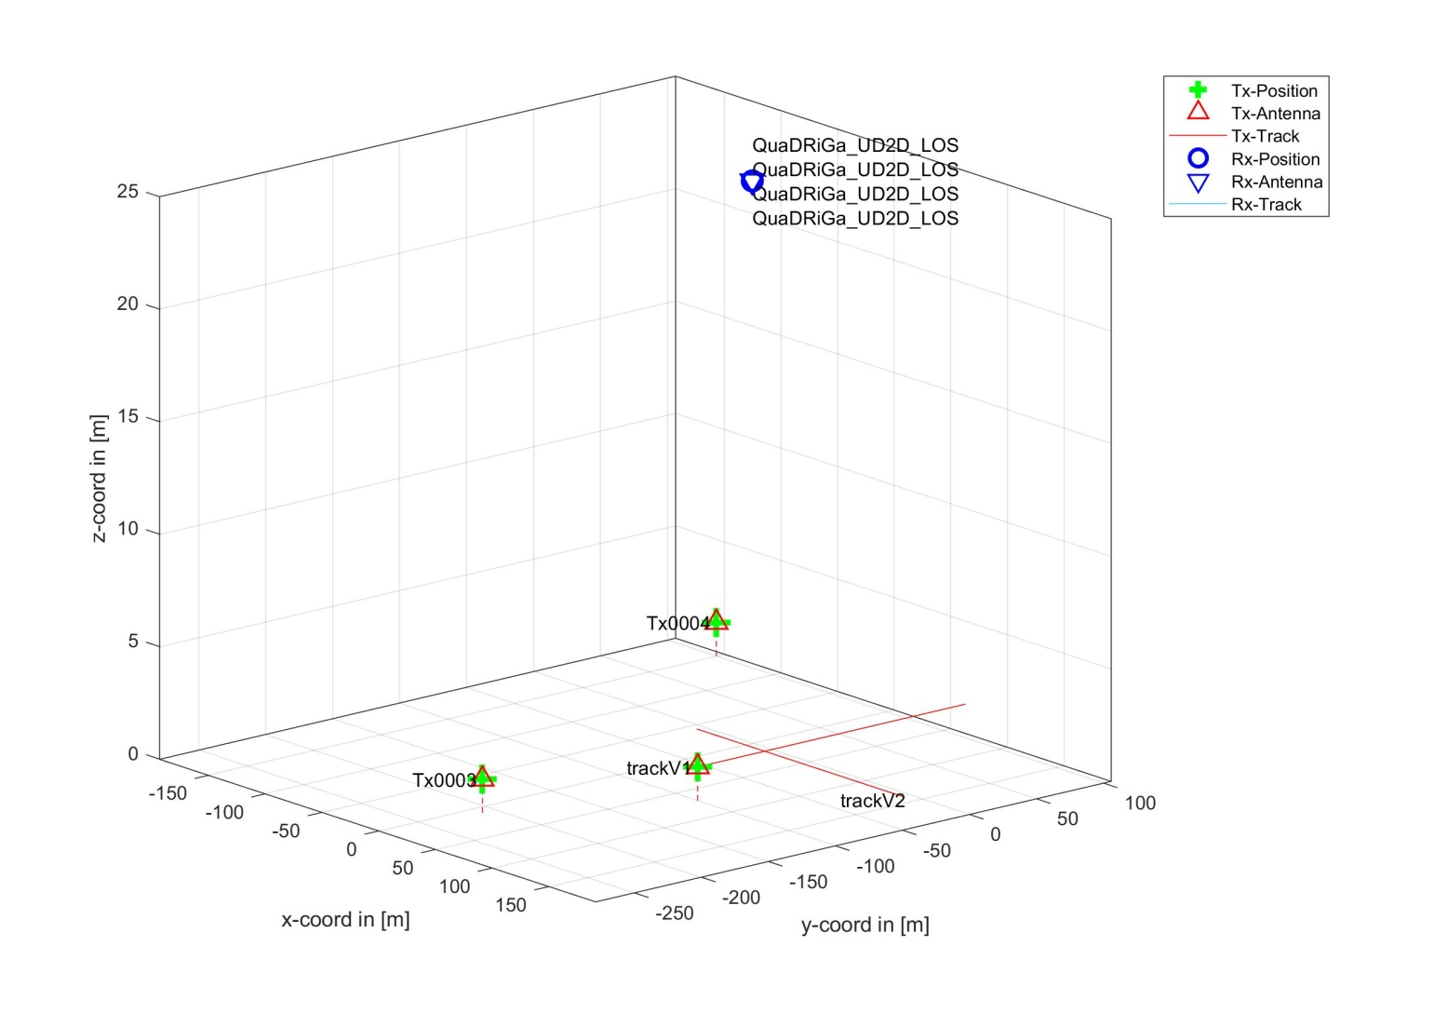
Scenario

Slide 6
Results with 64 antennas
SNR(dB) | Modulation order | BER user 1 | BER user2
-13 | 2 | 7.0% | 22.1%
-10 | 2 | 2.4% | 14.3%
-10 | 4 | 6.7% | 19.8%
-6 | 2 | 0.2% | 4.2%
-6 | 4 | 1.5% | 7.5%
-3 | 4 | 0.1% | 4.0%
-3 | 16 | 5.2% | 16.2%

Slide 7
Results with 64 antennas
SNR(dB) | Modulation order | BER user 1 | BER user2
0 | 4 | 0.0% | 0.6%
0 | 16 | 1.6% | 10.2%
3 | 16 | 0.3% | 4.8%
3 | 64 | 4.8% | 13.0%
6 | 64 | 1.8% | 8.3%
10 | 64 | 0.2% | 3.4%
10 | 256 | 3.2% | 9.9%

Slide 8
Results with 16 antennas
SNR(dB) | Modulation order | BER user 1 | BER user2
-13 | 2 | 17.3% | 31.9%
-10 | 2 | 8.9% | 24.5%
-10 | 4 | 16.8% | 30.6%
-6 | 2 | 1.8% | 12.4%
-6 | 4 | 6.9% | 20.4%
-3 | 2 | 0.2% | 5.6%
-3 | 4 | 1.2% | 12.7%

Slide 9
Results with 16 antennas
SNR(dB) | Modulation order | BER user 1 | BER user2
0 | 4 | 0.2% | 5.7%
0 | 16 | 8.0% | 19.4%
3 | 16 | 3.1% | 12.5%
6 | 16 | 0.7% | 6.5%
6 | 64 | 7.1% | 16.2%
10 | 64 | 2.4% | 9.4%

Slide 10
Constellation graphs
The constellation graphs for user 1 (in the midpoint of the track) obtained with 1, 4, 16 and 64 antennas are shown for the following situations:
SNR=-3dB, order=4
SNR=0dB, order=4
SNR=0dB, order=16
SNR=3dB, order=16

Slide 11
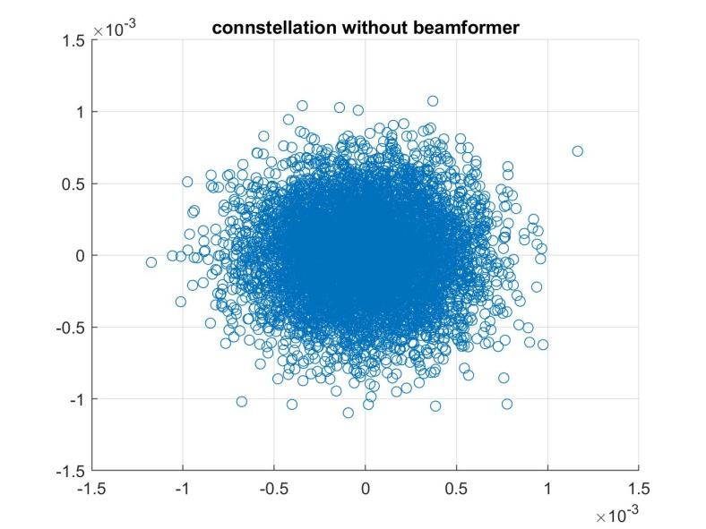
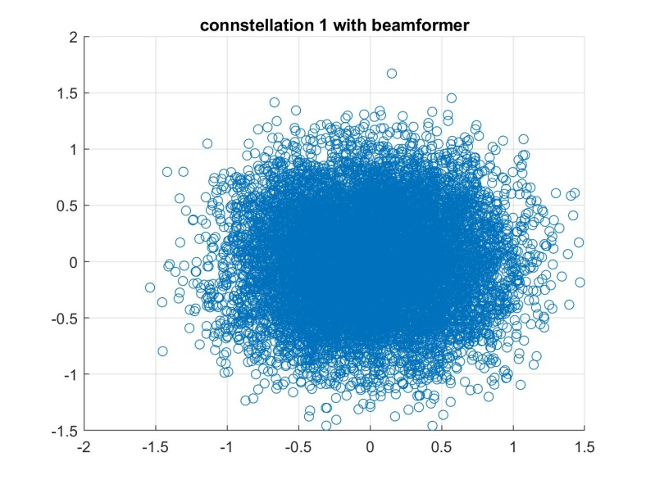
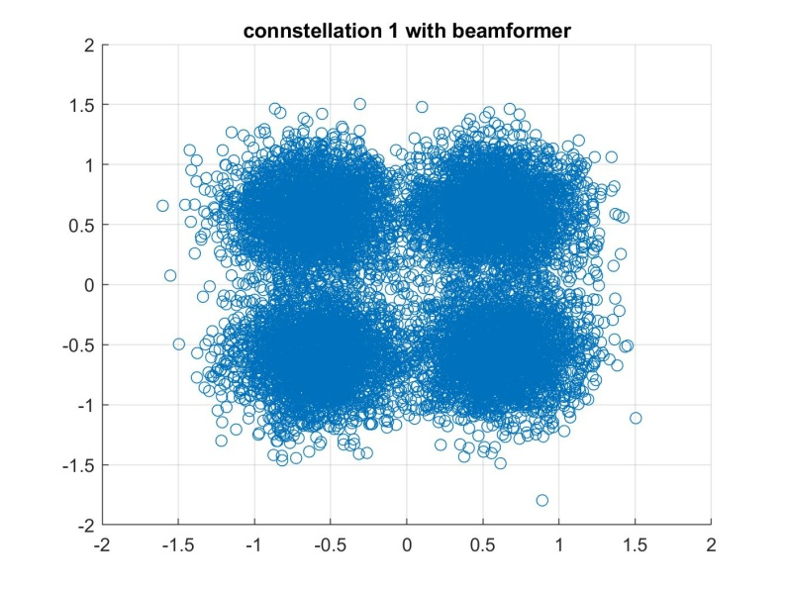
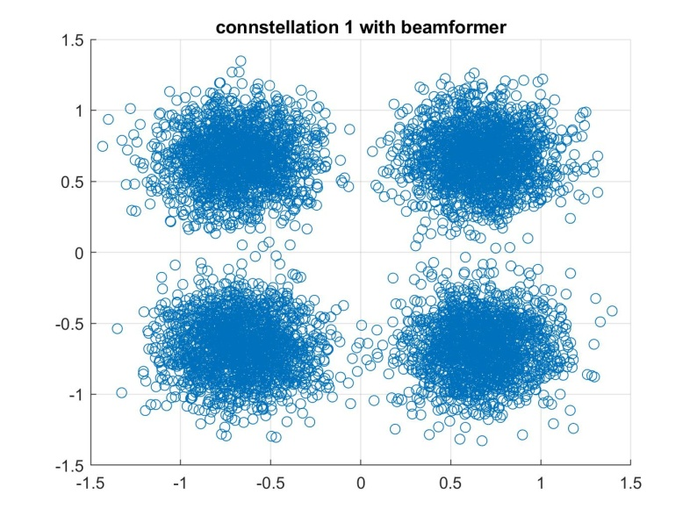
SNR=-3dB, order=4

Slide 12
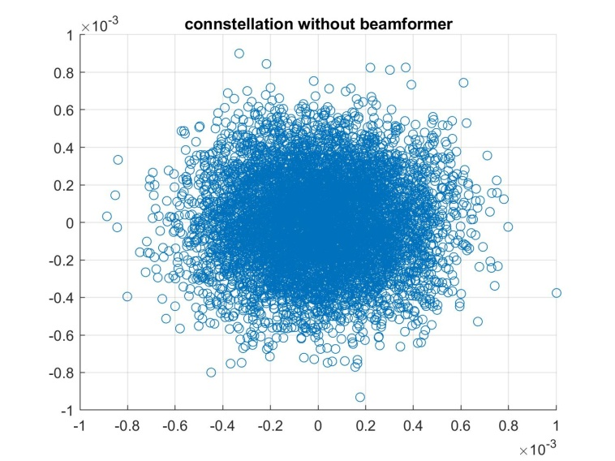
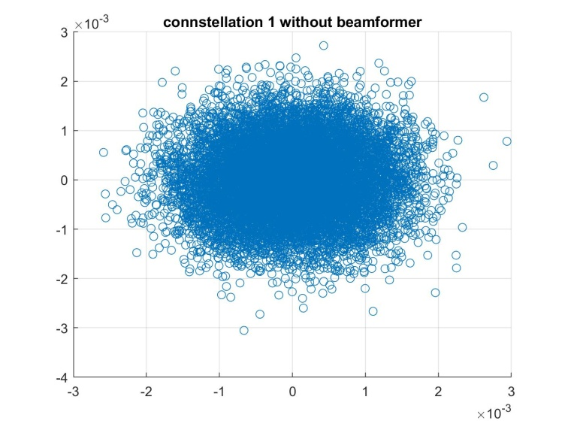
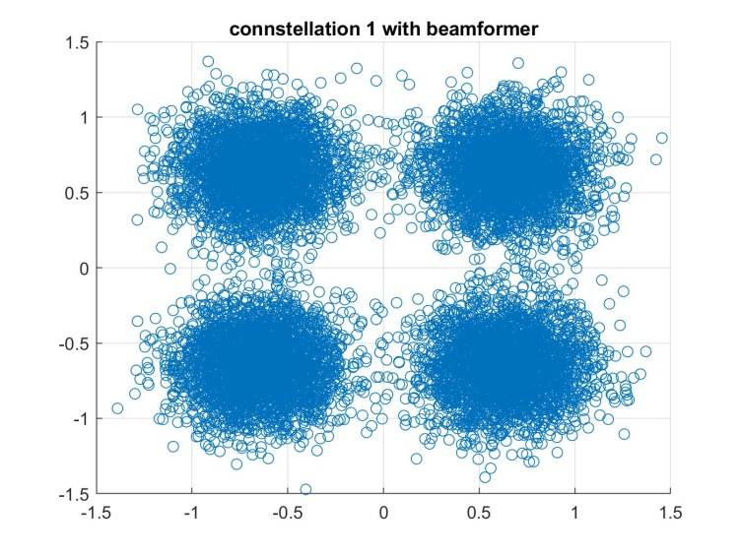
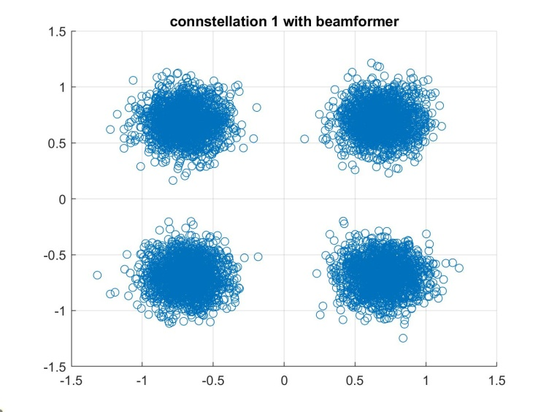
SNR=0dB, order=4

Slide 13
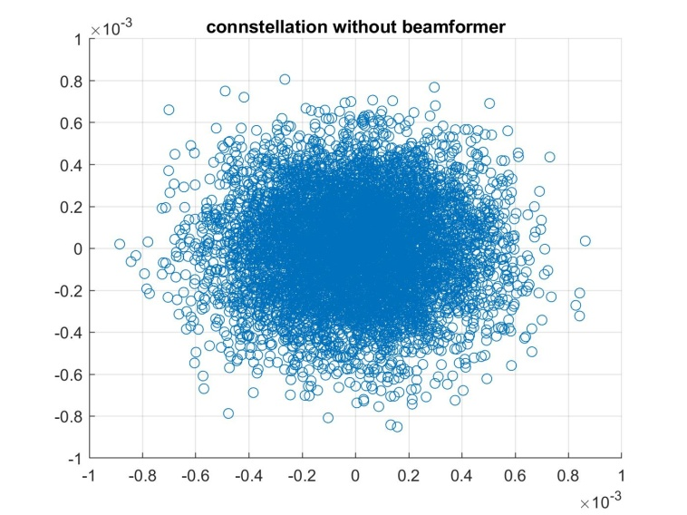
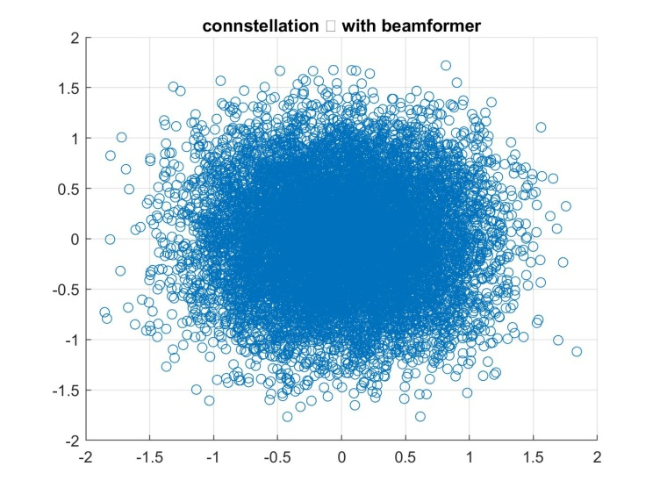
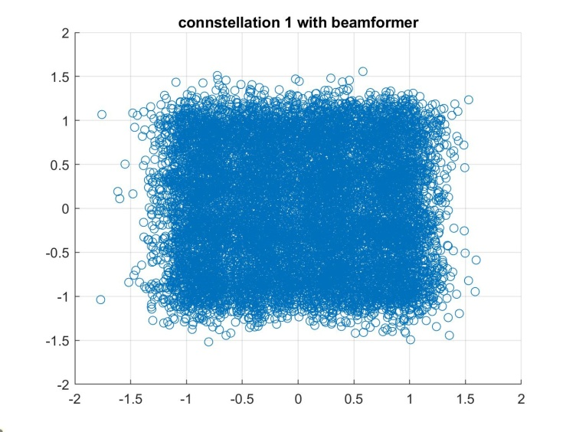
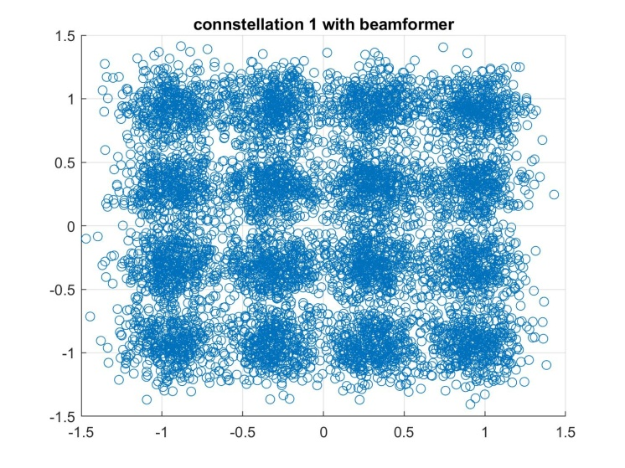
SNR=0, order=16

Slide 14
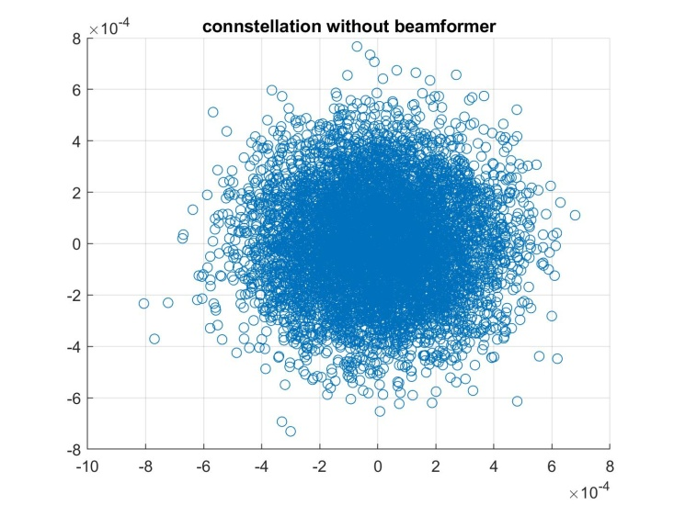
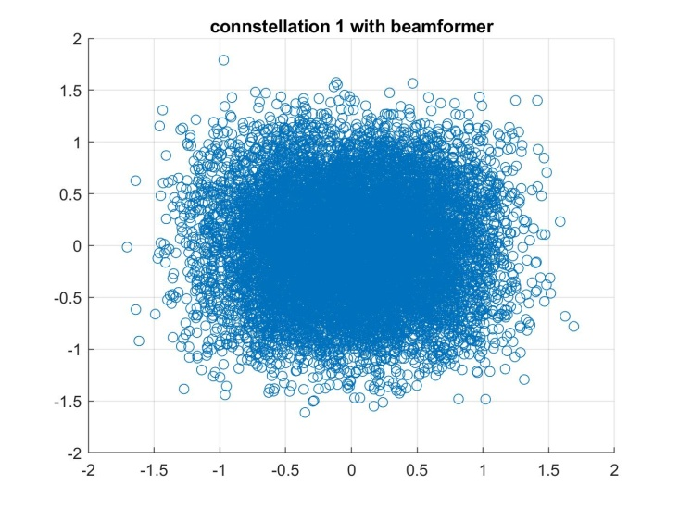
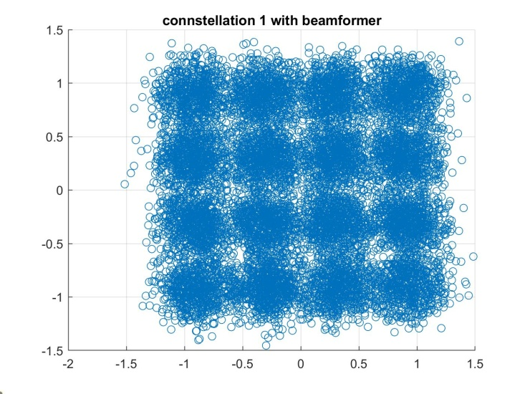
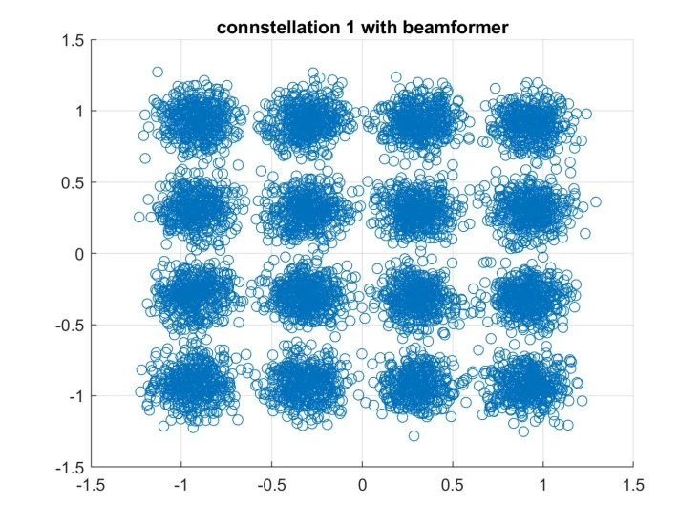
SNR=3dB, order=16

Slide 15
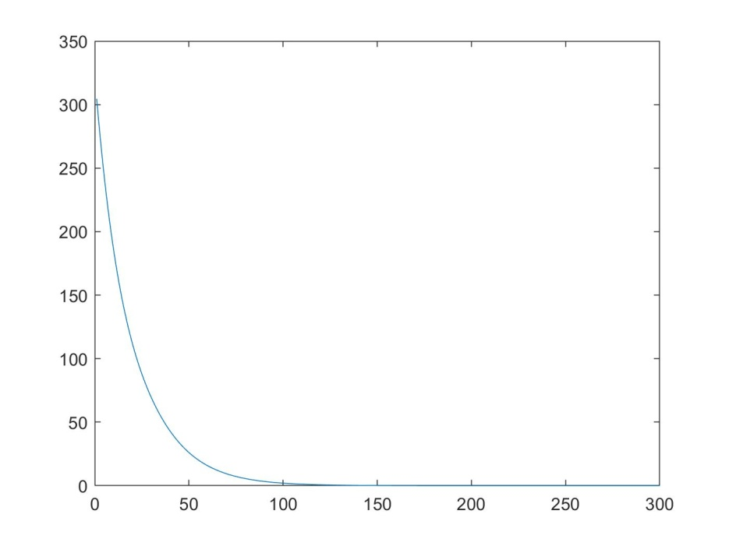
LMS convergence
To set the number of steps of the LMS algorithm the norm of the distance from the asymptotic values of the weights has been calculated and plotted

Slide 16
Possible improvements
The main issues of the algorithm used are that it does not take account of doppler shift and frequency offsets and that it is not able to allow multiple access when the 2 users are too close each other
A different pilot scheme can be introduced to estimate the doppler shift
OFDMA or OFDM-TDMA or OFDM-FDMA can be used to allow multiple access when the users are too close in space

